Slide 1


Dan’s FrappEccino Hell Stakeholder Check-in
11/11/22

Slide 2
Agenda
Sprint Planning
Burndown/Sprint Board
Scrum Logs
Demo

Slide 3
Sprint Planning
Sprint Goal:
Become Feature Complete
Balance Model
Employee Management Features
Bug Fixes
Nice-to-haves
Drink Images
Points:
23 - accomplished previous sprint
27 – New points
7 – rolled over from previous sprint
34 – total points

Slide 4
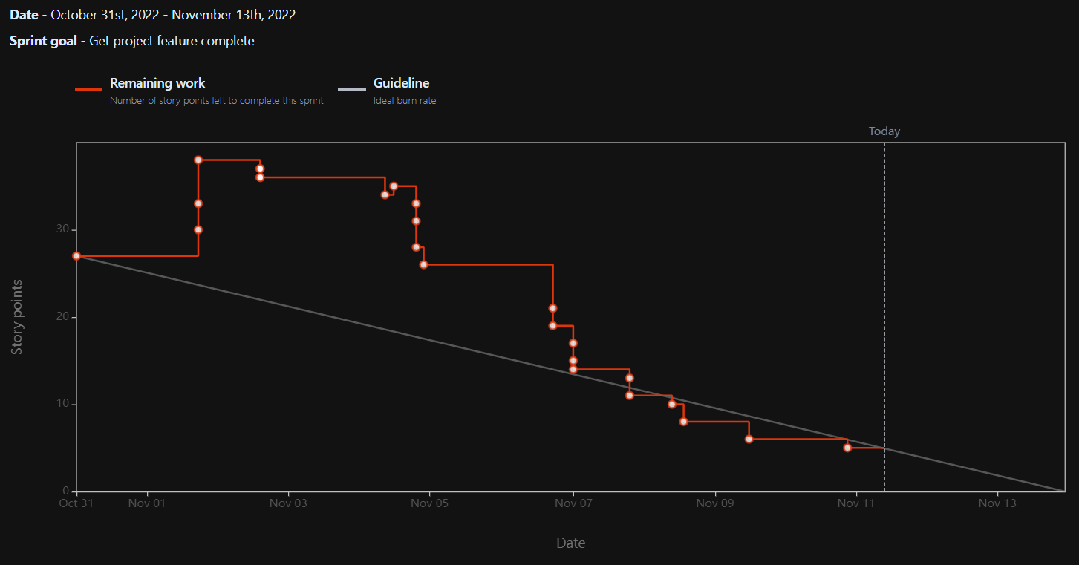
Burndown

Slide 5
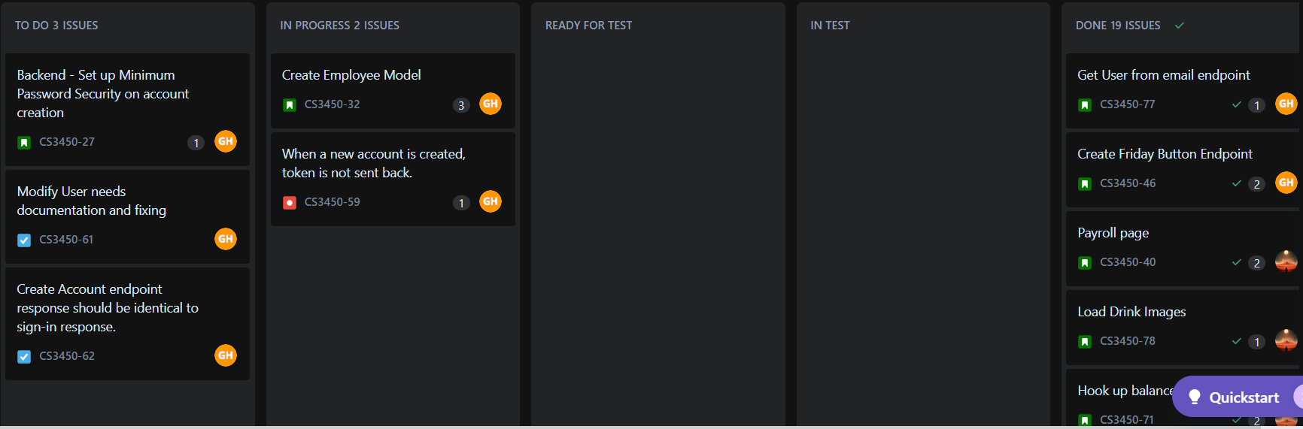
Sprint Board

Slide 6
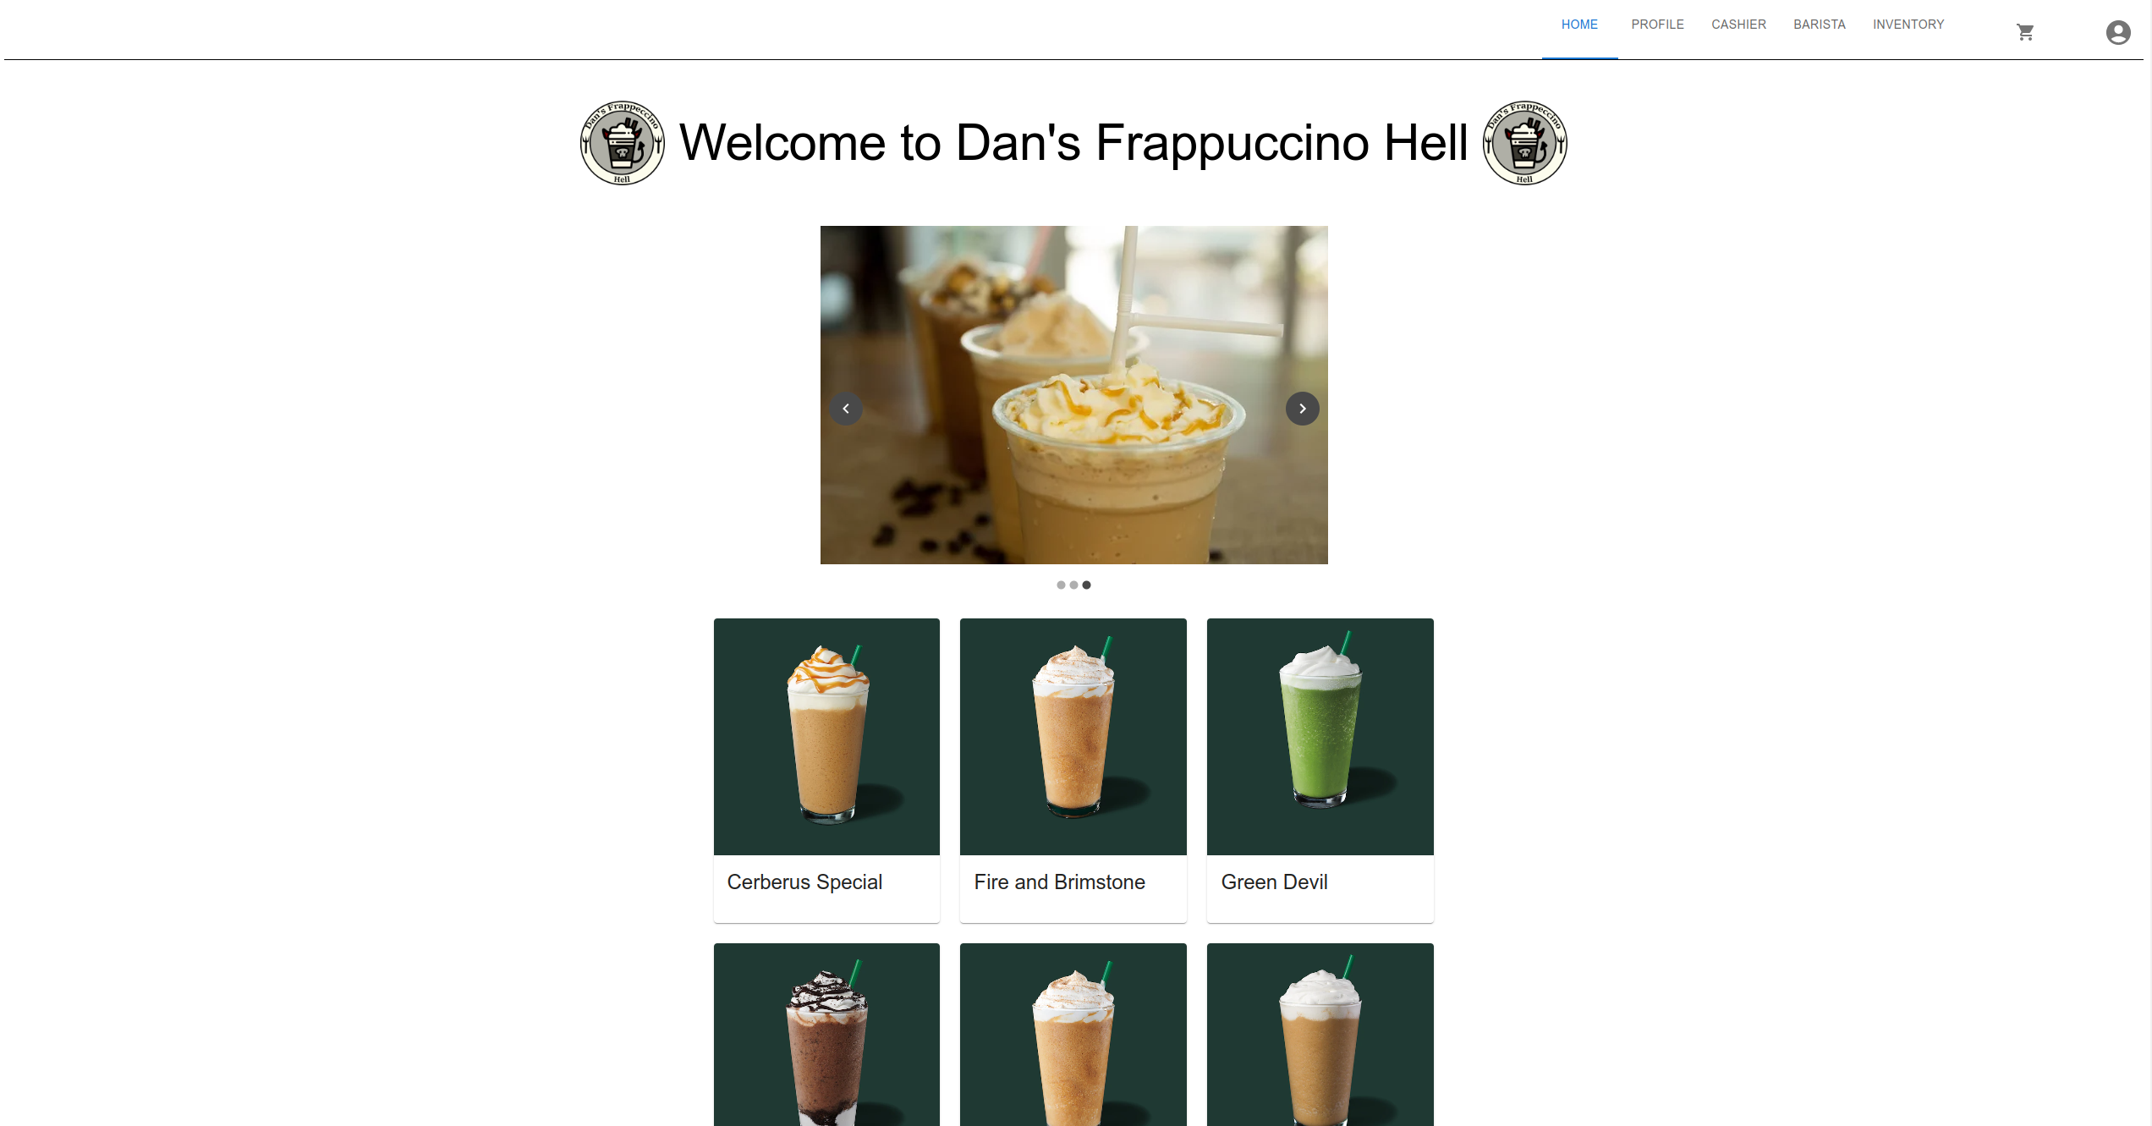
Demo

